Slide 1

RPC & NFS
Computer System Engineering, Fall 2019. (IPADS, SJTU)
Enable Client/Server model
Yubin Xia

Slide 2


Current Status
We can build a Taobao from scratch on one machine!
Web Server
Accept requests & reply files in HTTP
7 layers, inode, FAT, VFS, FS API, Crash consistency
File System
Socket
Disk Driver
NIC Driver
Interrupt handling
System Bus
PIO, MMIO, DMA
Disk
NIC
Disk structure, SSD, Optimization

Slide 3



Challenges
One machine is NOT enough
More and more pictures to save
More and more clients to serve
Multiple servers are needed
One server with large storage, to save more files
Multiple servers run web server, to server more clients
How to build a Network File System (NFS)?
Seems like every server can share the large storage

Slide 4
RPC
Remote Procedure Call

Slide 5
RPC
RPC （Remote Procedure Call)
Allow a procedure to execute in another address space without coding the details for the remote interaction
RPC History
Idea goes back in 1976
Sun's RPC: first popular implementation on Unix
Used as the basis for NFS
RMI (Remote Method Invocation)
Object-oriented version of RPC, e.g. in Java

Slide 6
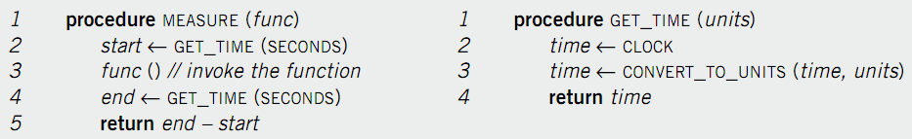
Example of RPC
Re-implement MEASURE and GET_TIME
Run GET_TIME on a server
Call GET_TIME on a client
Notes:
Occam's Razor.

Slide 7
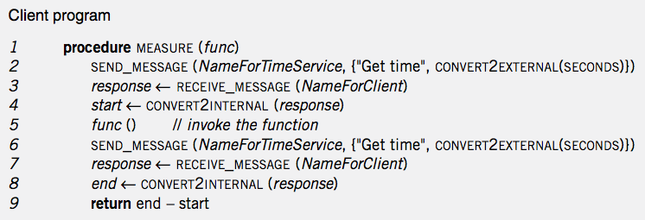
Client Program
Notes:
Marshal: line 2 6
unmarshal: line 4 8

Slide 8
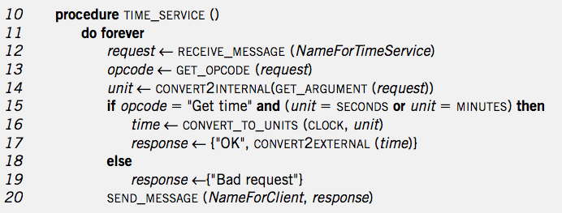
Service Program
Notes:
Marshal: 16-19
Unmarshal: 13 14

Slide 9
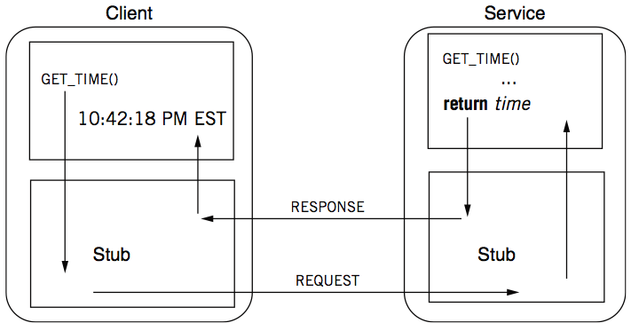
RPC Calling Process

Slide 10
RPC Stub
Client stub
Put the arguments into a request
Send the request to server
Wait for a response
Service stub
Wait for a message
Get the parameters from the request
Call the procedure (e.g. GET_TIME)
Put the result into a response
Send the response to the client
Stub: hide communication details from up-level code, so that up-level code does not change

Slide 11
Client Program using RPC
procedure MEASURE (func)
start <- GET_TIME(SECONDS)
func()
end <- GET_TIME(SECONDS)
return end - start
Note: this code is not changed
This is stub of client
procedure GET_TIME (units)
SEND_MESSAGE(ServerName, {"Get time", CONVERT2EXTERNAL(units)})
response <- RECEIVE_MESSAGE(ClientName)
if GET_RETCODE(response) != "OK"
HANDLE_ERROR(response)
else
return CONVERT2INTERNAL(GET_ARGUMENT(response))
Notes:
Marshal: line 2 6
unmarshal: line 4 8

Slide 12
Server Program using RPC
procedure GET_TIME (units)
time <- CLOCK
time <- CONVERT_TO_UNITS(time, units)
return time
Note: this code is not changed
This is stub of server
procedure TIME_SERVICE ()
do forever
request <- RECEIVE_MESSAGE(ServerName)
opcode <- GET_OPCODE(request)
arg <- CONVERT2INTERNAL(GET_ARGUMENT(request))
if opcode = "Get time" and (arg = SECONDS or arg = MINUTES) then
retval <- GET_TIME(arg)
response <- {"OK", CONVERT2EXTERNAL(retval)}
else
response <- {"Bad request"}
SEND_MESSAGE(ClientName, response)
Notes:
Marshal: line 2 6
unmarshal: line 4 8

Slide 13
Question
What is inside a message?
Service ID (e.g., function ID)
Service parameter (e.g., function parameter)
Using marshal / unmarshal

Slide 14
RPC Request
UDP header...
Xid
call/reply
rpc version
program #
program version
procedure #
auth stuff
arguments
X is short for "transaction"
Client reply dispatch uses xid
Client remembers the xid of each call
Server dispatch uses prog#, proc#

Slide 15
RPC Reply
UDP header …
Xid
call/reply
accepted? (vs bad rpc version, or auth failure)
auth stuff
success? (vs bad prog/proc #)
results

Slide 16
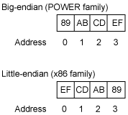
Marshal / Unmarshal
Marshal
Convert an object into an array of bytes with enough annotation so that the unmarshall procedure can convert it back into an object
Serialization is not easy
E.g., big endian VS. little endian
Big endian on network
Two functions: htons(), ntohs()
Using IEEE 754 or not?
What about an array?
What about a pointer?

Slide 17
Automatic Stub Generation
Generate stubs from an interface specification
Tool to look at argument and return types
Generate marshal and unmarshal code
Generate stub procedures
Saves programming (thus less error)
Ensures agreement on argument types
E.g., consistent function ID

Slide 18
RPC System Components
1. Standards for wire format of RPC message and data types
2. Library of routines to marshal / unmarshal data
3. Stub generator, or RPC compiler, to produce "stubs"
For client: marshal arguments, call, wait, unmarshal reply
For server: unmarshal arguments, call real function, marshal reply

Slide 19
RPC System Components
4. Server framework:
Dispatch each call message to correct server stub
5. Client framework:
Give each reply to correct waiting thread / callback
6. Binding: how does client find the right server?

Slide 20
Client Framework
Keeps track of outstanding requests
For each, xid and caller's thread / callback
Matches replies to caller
Might be multiple callers using one socket
Usually handles timing out and retransmitting

Slide 21
Server Framework
Type-1: Create a new thread per request
Master thread reads socket[s]
Type-2: Use a fixed pool of threads
Use a queue if too many requests
E.g., NFS server
Type-3: Just one thread for serial execution
Simplifies concurrency, e.g., the X server

Slide 22
Concurrent RPC
Key feature: support for concurrent RPCs
If one RPC takes multiple blocking steps, can the server serve another one in the meantime?
For example, DNS service routine itself is an RPC client
May also avoid deadlock if one sends RPC to itself
Notes:
fdcb() calls un-marshaling function

Slide 23
Client & Server (C/S Model)
Enforced modularity

Slide 24
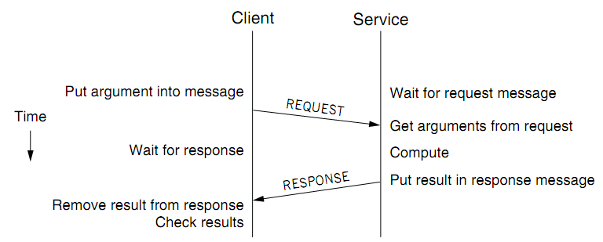
Client/Service Organization
Limit interactions to explicit messages
Client: request; service: response or reply
On different computers, connected by a wire
Chap 5 will explain how to get them into one computer

Slide 25
C/S Model
Client/Service model
Separates functions (abstraction)
Enforces that separation (enforced modularity)
Reduce fate sharing but not eliminate it
Notes:
Occam's Razor.

Slide 26
Multiple Clients and Services
One services can work for multiple clients
E.g., one file server for multiple clients
One client can use several services
E.g., one client can connect to multiple file servers
One module can be both a client and a service
E.g., printer as a service for printing request, while also as a client of the file service

Slide 27
Trusted Intermediaries
Service as trusted 3rd party
Run critical procedures as a service
E.g., a file service to keep clients' file distinct, email service
Enforces modularity among multiple clients
Ensures that a fault in one client has limited effect on another client
Thin client computing (the ultimate version of C/S?)
Simplify clients by having the trusted intermediary provide most functions
Only the trusted intermediaries run on powerful computers
What if the powerful computers fail…

Slide 28
RPC != PC
RPCs can reduce fate sharing
Set a time-out for message lost or service failure
RPCs introduce new failures: no response
RPCs take more time
Stub itself may cost more than a service
Consider using RPC in device driver: time-out error
Not suitable for all cases

Slide 29
RPC: Failure Handling
Most network systems and applications also have these considerations
1. At least once
Client keeps resending until server responds
Only OK if without side effects on server
2. At most once
Client keeps resending (may time-out)
Server remembers requests and suppress duplicates?
Idempotent functions
3. Exactly once
This is often what we really want
Hard to do in a useful way, later in Chap-8 and 10
Most RPC systems do #1 or #2

Slide 30
Other Differences
Language support
Some features do not combine well with RPC
E.g., inter-procedure communicate through global variable
Data structure that contains pointers
Security consideration
Both client and server need authentication
Side channel attacks through network pattern

Slide 31
Questions
Q: Why RPC and C/S?
Programmers make mistakes
Mistakes propagate easily
Enforce modularity
Q: What does RPC do, exactly? Can we use other ways?
E.g., socket? HTTP? Why not use them?
Be more friendly for programmers

Slide 32
CASE STUDY: CORBA

Slide 33
IDL for Interface Definition
Can the service uses Java while client uses C?
Yes, they just need to use the same RPC protocol
IDL: describe a function for all languages
Interface Definition Language
Specify names, parameters, return values, etc.
Pre-compiler use IDL to generate stubs for client/server
Similar to function prototypes

Slide 34
IDL Example: CORBA IDL
module BankSimple {
struct CustomerDetails {
string name;
short age;
};
interface Bank {
CustomerDetails getCustomerDetails (in string name);
};
};

Slide 35
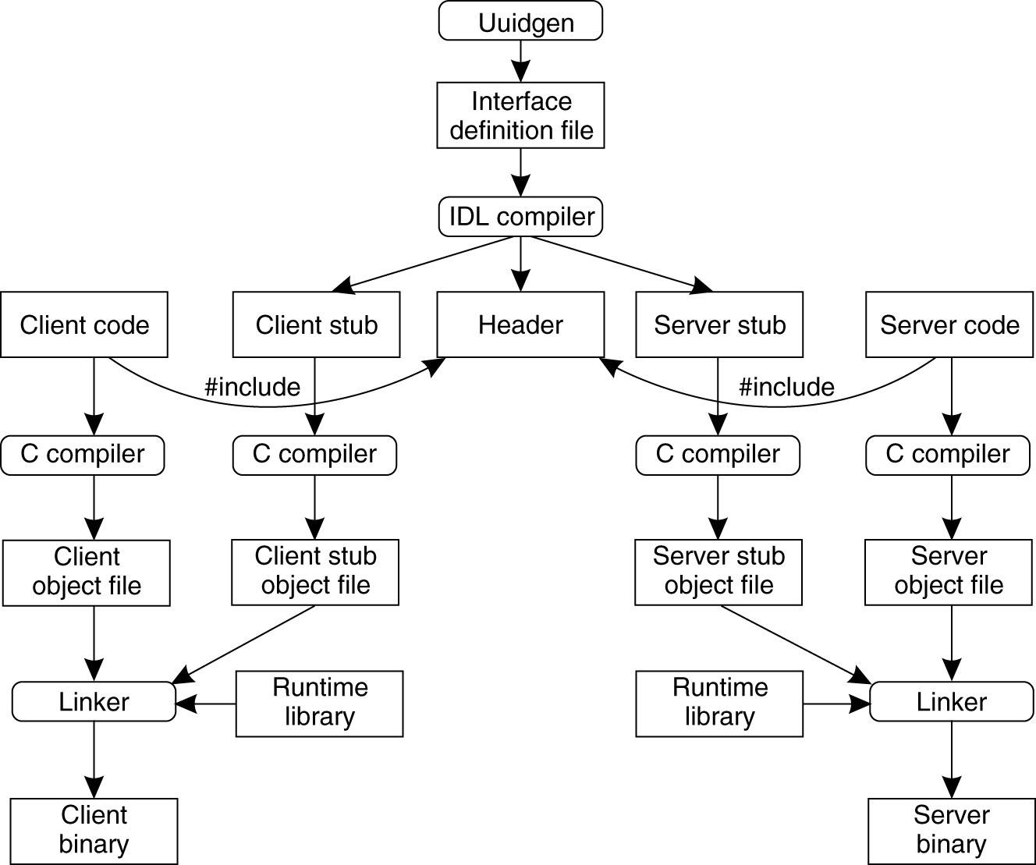
Putting Together
Programmer
Generated

Slide 36
Binding a Client to a Server
Registration of a server makes it possible for a client to locate the server and bind to it
Server location is done in two steps:
Locate the server's machine
Locate the server on that machine
'Server' here means service in software

Slide 37
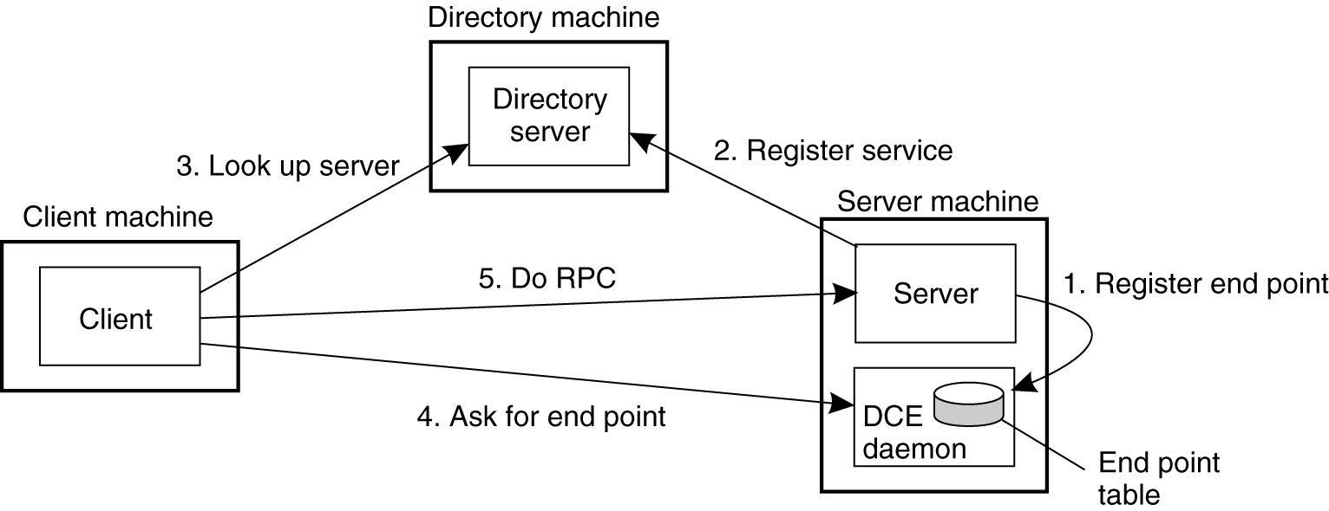
Binding a Client to a Server: Example
DCE example: (Distributed Computing Environment)

Slide 38
Case Study: NFS

Slide 39
NFS (Network File System)
History
Sun, 1980s, designed for workstations
Centralized management: easy to share & backup files
Cost benefit: workstations without disks
NFS goals
Transparency: compatibility with existing applications
OS independent: clients even in DOS
Easy to deploy
# mount –t nfs 10.131.250.6:/nfs/dir /mnt/nfs/dir

Slide 40
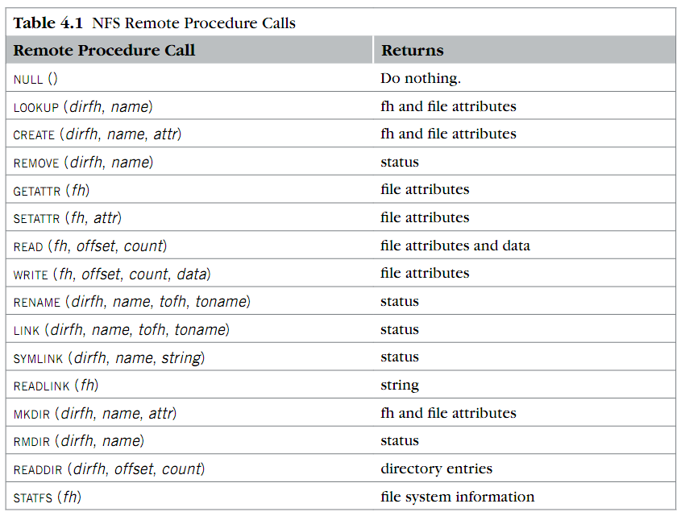
RPC in NFS
Where is OPEN and CLOSE?

Slide 41
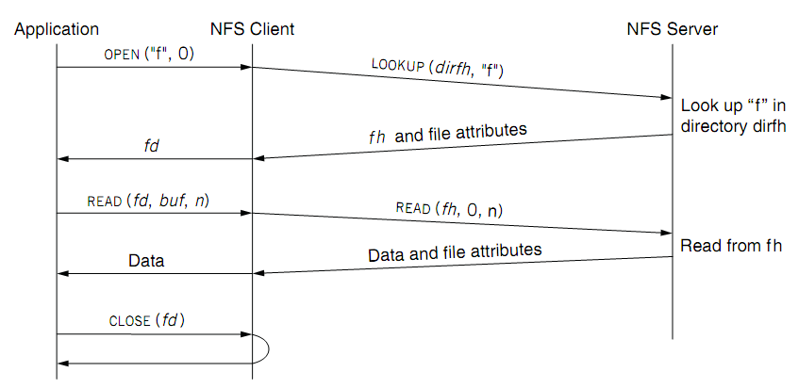
NFS Overview
fd <--> fh (file handler)
No state after open()

Slide 42
File Handler for a Client
File handler contains three parts
File system identifier: for server to identify the file system
inode number: for server to locate the file
Generation number: for server to maintain consistency of a file
Can still work across server failures
E.g., server reboot
Q: Why not put path name in the handle?

Slide 43
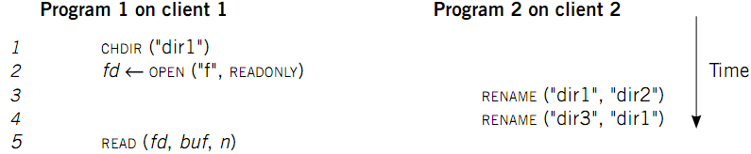
Case 1: Rename After Open
UNIX Spec:
Program 1 should read "dir2/f"
NFS should keep the spec

Slide 44
Stateless on NFS server
Stateless on NFS server
Each RPC contains all the information
Q: What about states like file cursor?
Client maintains the states, including the file cursor
Client can repeat a request until it receives a reply (at least once)
Server may execute the same request twice
Solution: each RPC is tagged with a transaction number, and server maintains some "soft" state: reply cache
Q: What if the server fails between two same requests?
Notes:
What about the case of "delete-after-open"?

Slide 45
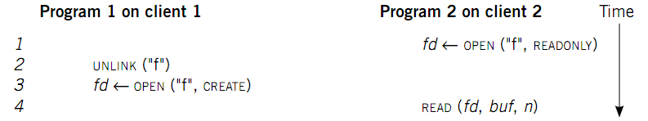
Case 2: Delete After Open
UNIX spec:
On local FS, program 2 will read the old file
How to avoid program 2 reading new file?
Generation number
"stale file handler"
Not the same as UNIX spec! It's a tradeoff...

Slide 46
Cache on the Client
NFS client maintains various caches
Stores a vnode for every open file
Know the file handles
Recently used vnodes, attributes, recently used blocks, mapping from path name to vnode
Cache benefits
Reduce latency
Less RPC, reduce load on server
Cache coherence is needed

Slide 47
Coherence
Read/write coherence
On local file system, READ gets newest data
On NFS, client has cache
NFS could guarantee read/write coherence for every operation, or just for certain operation
Close-to-open consistency
Higher data rate
GETATTR when OPEN, to get last modification time
Compare the time with its cache
When CLOSE, send cached writes to the server
Notes:
Mixed blocks, old and new

Slide 48
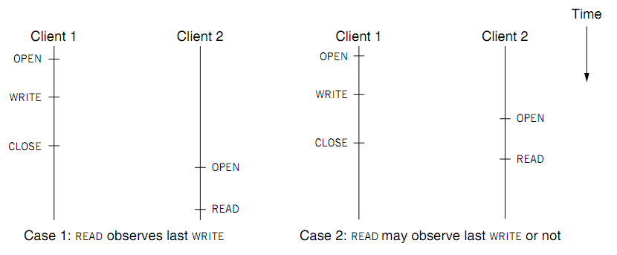
Coherence
Two cases of close-to-open consistency
More contents of consistency in chapter 9 and 10

Slide 49
Extend the UNIX FS to support NFS
Vnode
Abstract whether a file or directory is local or remote
In volatile memory (why?)
Support several different local file system
Where should vnode layer be inserted?
Vnode API
Same as we learnt: OPEN, READ, WRITE, CLOSE…
Code of fd_table, current dir, file name lookup, can be moved up to the file system call layer

Slide 50
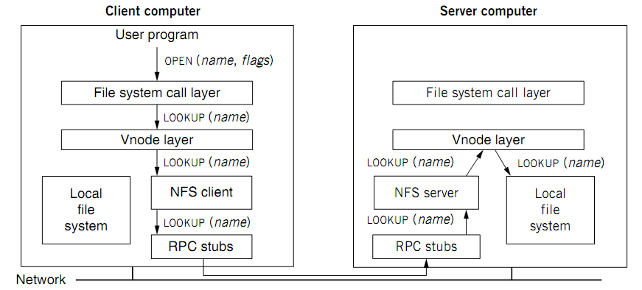
Extend the UNIX FS to support NFS

Slide 51
Reference Materials
Textbook
Chapter 4.2 & 4.5
RFC 1831: RPC Specification
http://www.ietf.org/rfc/rfc1831.txt?number=1831
RFC 1832: XDR Specification
http://www.ietf.org/rfc/rfc1832.txt?number=1832

